Slide 1
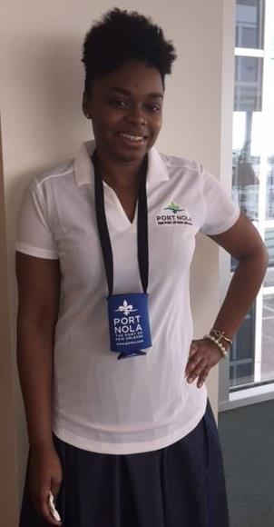
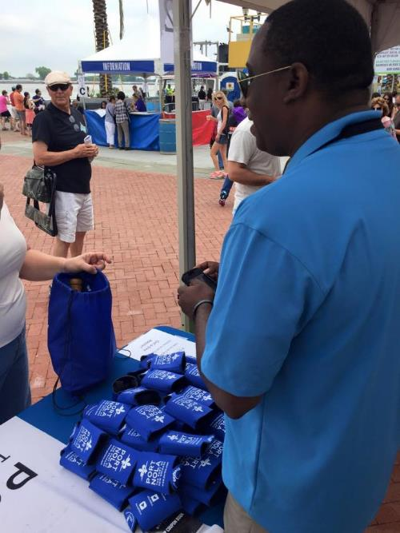
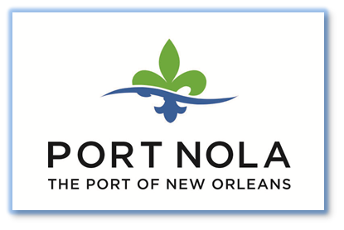
Port of New Orleans
French Quarter Festival Partnership
Special Events
Use this area for logo
(delete text box before placing logo)

